Slide 1
Mini Popper | Colt poppers | Pepper poppers | Plates | Wall feet
3 | 8 | 0 | 0 | 58
Bay | Stage | Target Type | Count | NS | Total | Hard Cover
1 | 22-01 Righty Tighty | USPSA | 9 | 3 | 12
2 | Bogged Down | USPSA | 10 | 1 | 11 | 2 Tux 1 50%
4 | Two For One | IPSC | 11 | 2 | 13 | 2 Tux 1 Right Diag 1 50%
5 | Not Even a Little | IPSC | 8 | 1 | 9 | 1 Tux 1 Left Diag
7 | Revenge | USPSA | 6 | 2 | 8 | 2 Tux 1 Left Diag
8 | 13-08 | USPSA | 6 | 3 | 9

Slide 2
Prop | Stage
Swinger | 2/Bay 2
Table | 3/Bay 5

Slide 3


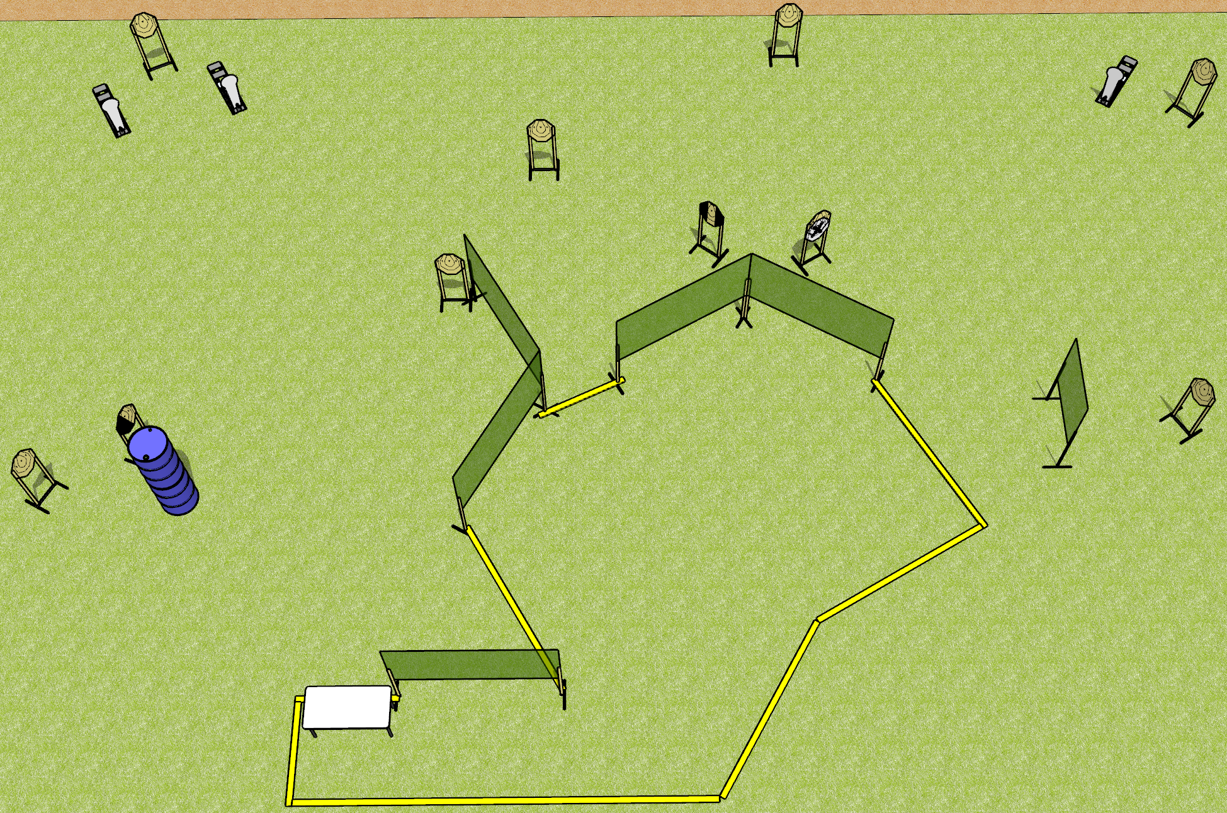
 | Dothan Gun Club – USPSA Match Not Even a Little Course Designer : Drew Coleman Bay: 5
Round Count 23 rounds 10 IPSC 3 colt poppers
Equipment List 12 wall feet Table 1 left, 1 tux 9 targets (8 + 1 NS)

Slide 4
Not Even a Little
Written Stage Briefing
Scoring: Comstock Rounds: 23
Targets: 10 IPSC, 3 steel
Start position: heels touching rear fault line, wrists below belt. Firearm is on table, unpropped, trigger guard over left or right mark. All magazines to be used on stage on table on the opposite side from the gun.
Stage Procedure: on the audible start signal, engage targets as they become available from within the shooting area.

Slide 5
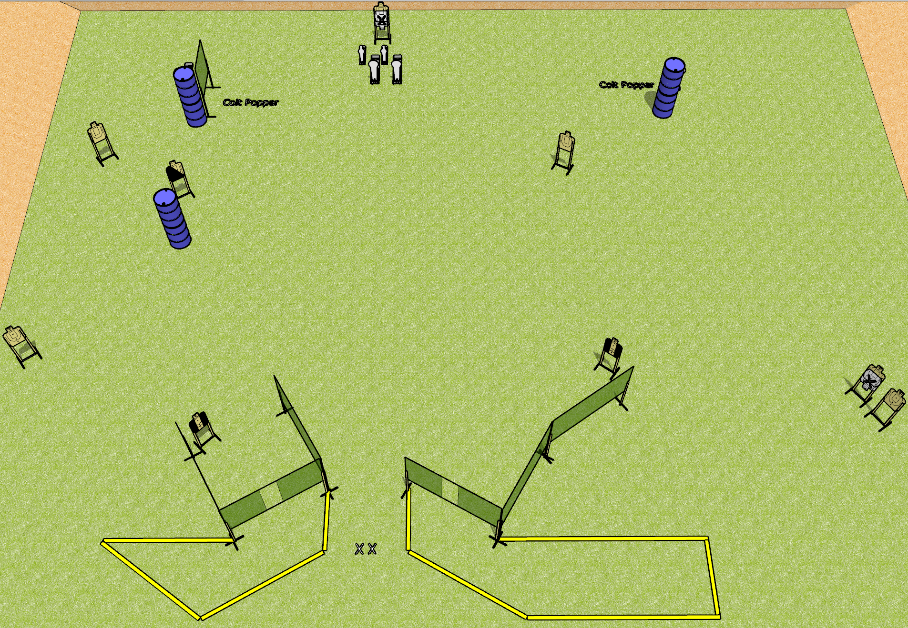
 | Dothan Gun Club – USPSA Match Revenge Course Designer : Drew and Patrick and Rodney Bay: 7
Round Count 24 rounds 9 USPSA 4 colt 2 mini
Equipment List 10 wall feet 2 tuxedos, 1 left diag 8 targets (6 + 2 NS)

Slide 6
Revenge
Written Stage Briefing
Scoring: Comstock Rounds: 24
Targets: 9 USPSA, 6 steel
Handgun start position: feet on X’s, wrists below belt. Handgun is loaded and holstered.
PCC start position: feet on X’s, stock on belt. Loaded carbine is held with both hands, safety on.
Stage Procedure: On the audible start signal, engage targets as they become available from within the shooting area.

Slide 7
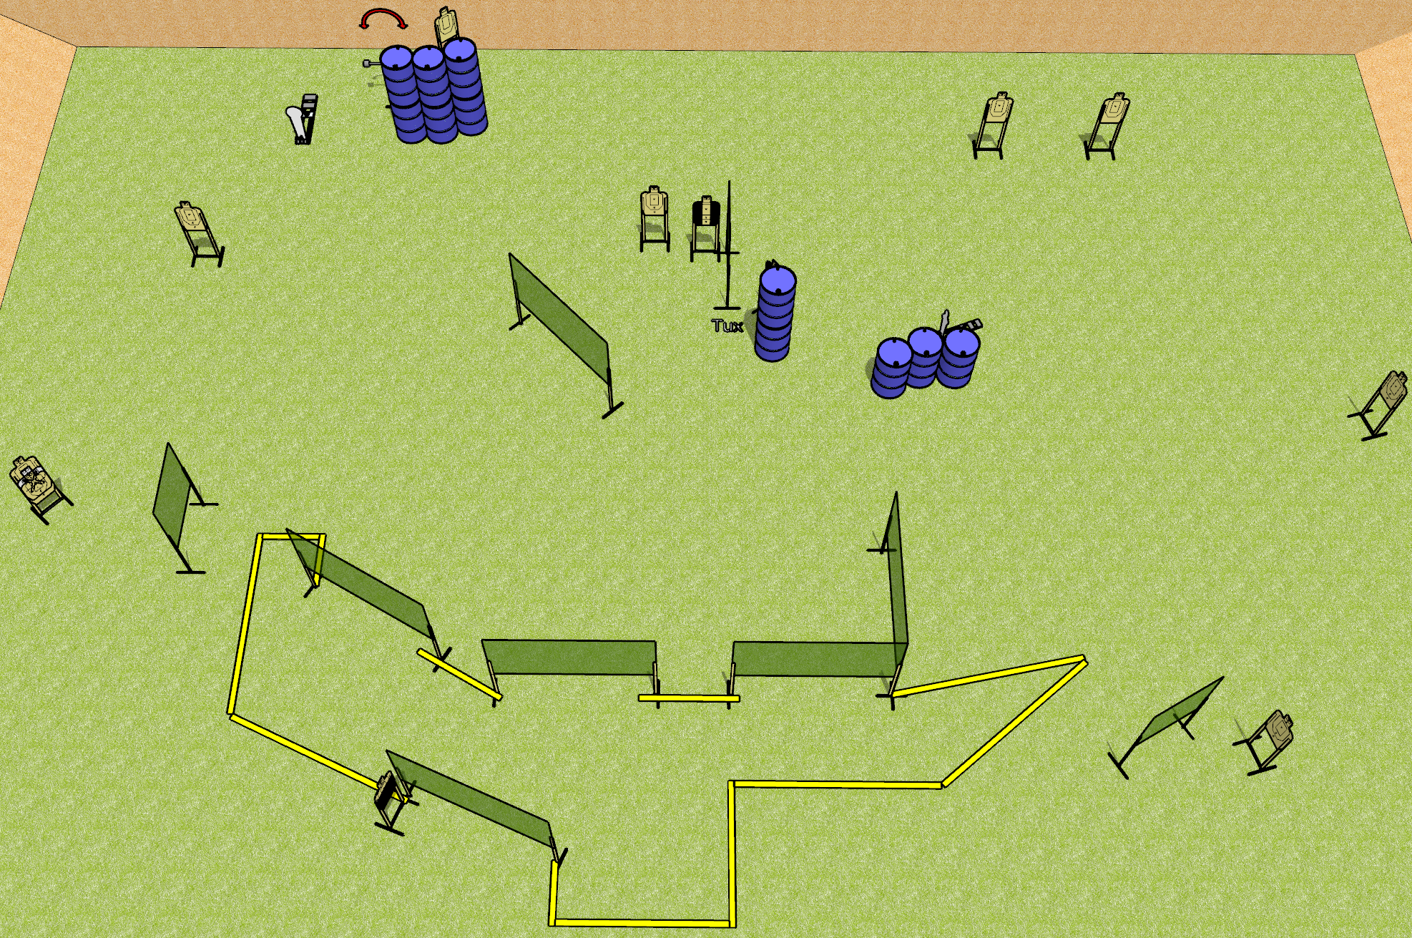
 | Dothan Gun Club – USPSA Match Bogged Down Course Designer : Drew Coleman Bay: 2
Round Count 28 rounds 13 USPSA 1 colt, 1 mini
Equipment List 15 wall feet 1 50%, 2 tux 1 NS 11 targets (10 + 1NS)

Slide 8
Bogged Down
Written Stage Briefing
Scoring: Comstock Rounds: 28
Targets: 13 USPSA, 2 steel
Handgun start position: anywhere inside the shooting area, wrists below belt. Handgun is loaded and holstered.
PCC start position: anywhere inside the shooting area, stock on belt. Loaded carbine is held with both hands.
Stage Procedure: on the audible start signal, engage targets as they become available from within the shooting area.
The swinger is activated by P1 and remains visible at rest.

Slide 9
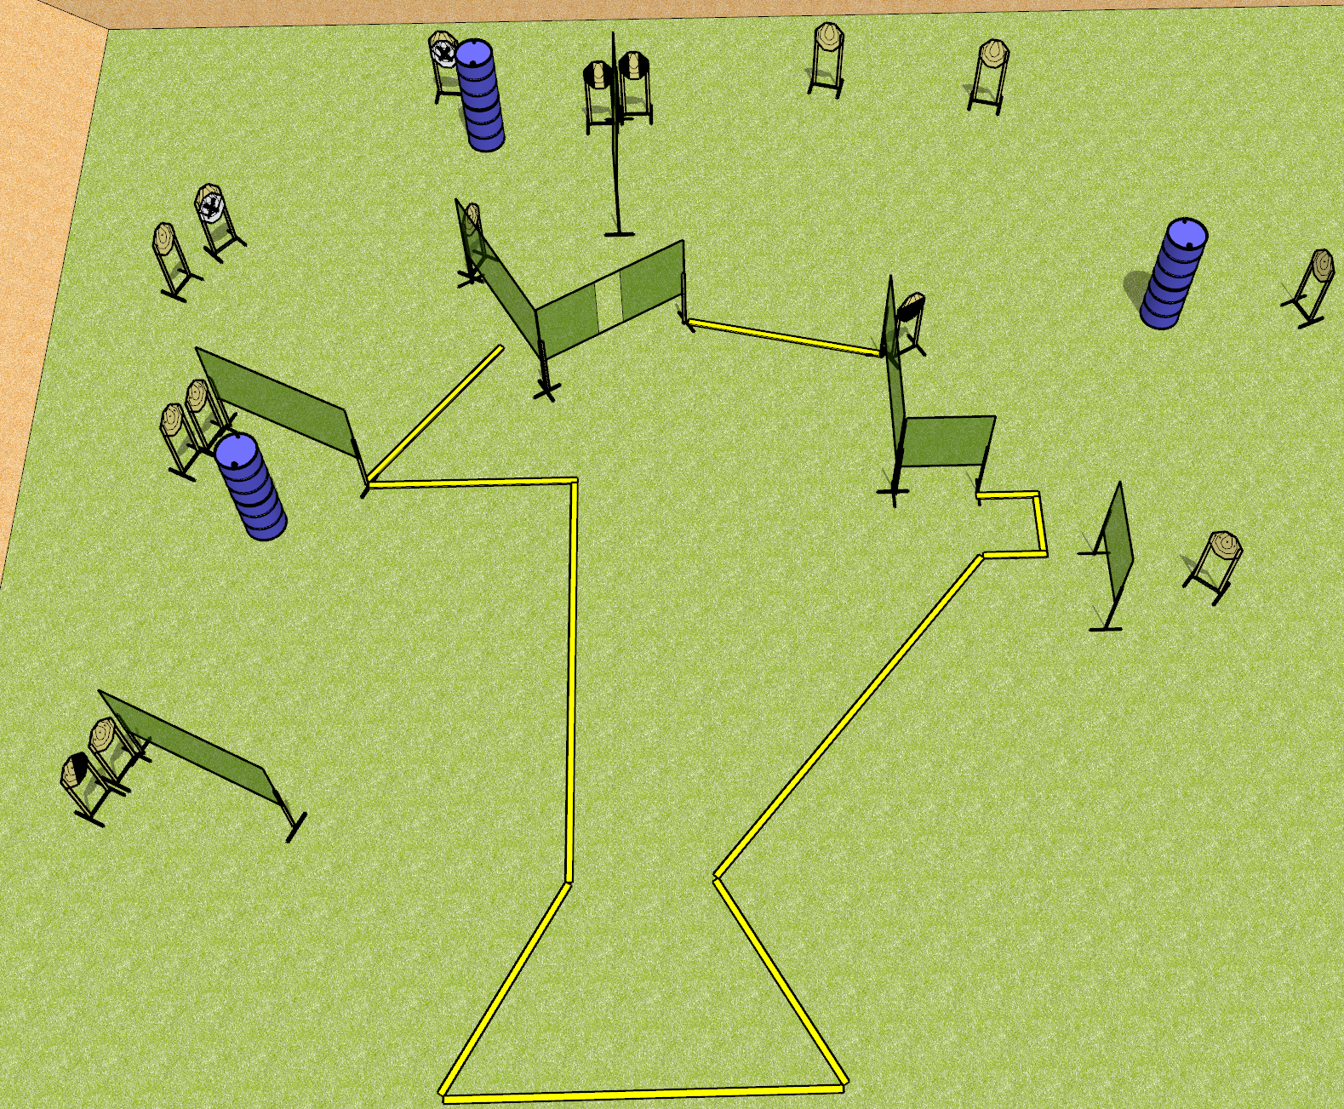
 | Dothan Gun Club – USPSA Match Two For One Course Designer : Drew Coleman Bay:
Round Count 30 rounds 15 IPSC
Equipment List 14 wall feet 3 foot fault lines for right side 1 right diag, 2 tux, 1 50% 13 targets (11 + 2 NS)

Slide 10
Two For One
Written Stage Briefing
Scoring: Comstock Rounds: 30
Targets: 15 IPSC
Handgun start position: Anywhere completely outside the shooting area, wrists below belt. Handgun is UNLOADED and holstered.
PCC start position: Anywhere completely outside the shooting area, stock on belt. UNLOADED carbine is held with both hands.
Stage Procedure: on the audible start signal, engage targets as they become available from within the shooting area.

